Slide 1
COMP4901K/Math4824B Machine Learning for Natural Language Processing
Lecture 23: Knowledge Graph and
Information Extraction
Instructor: Yangqiu Song
Slides credits: Heng Ji, Dan Roth, Evgeniy Gabrilovich

Slide 2
Outline
What is a knowledge graph?
What are the key techniques used in information extraction to construction scalable knowledge graphs?
What kinds of techniques are used in Google knowledge graph, the world’s largest knowledge graph?

Slide 3
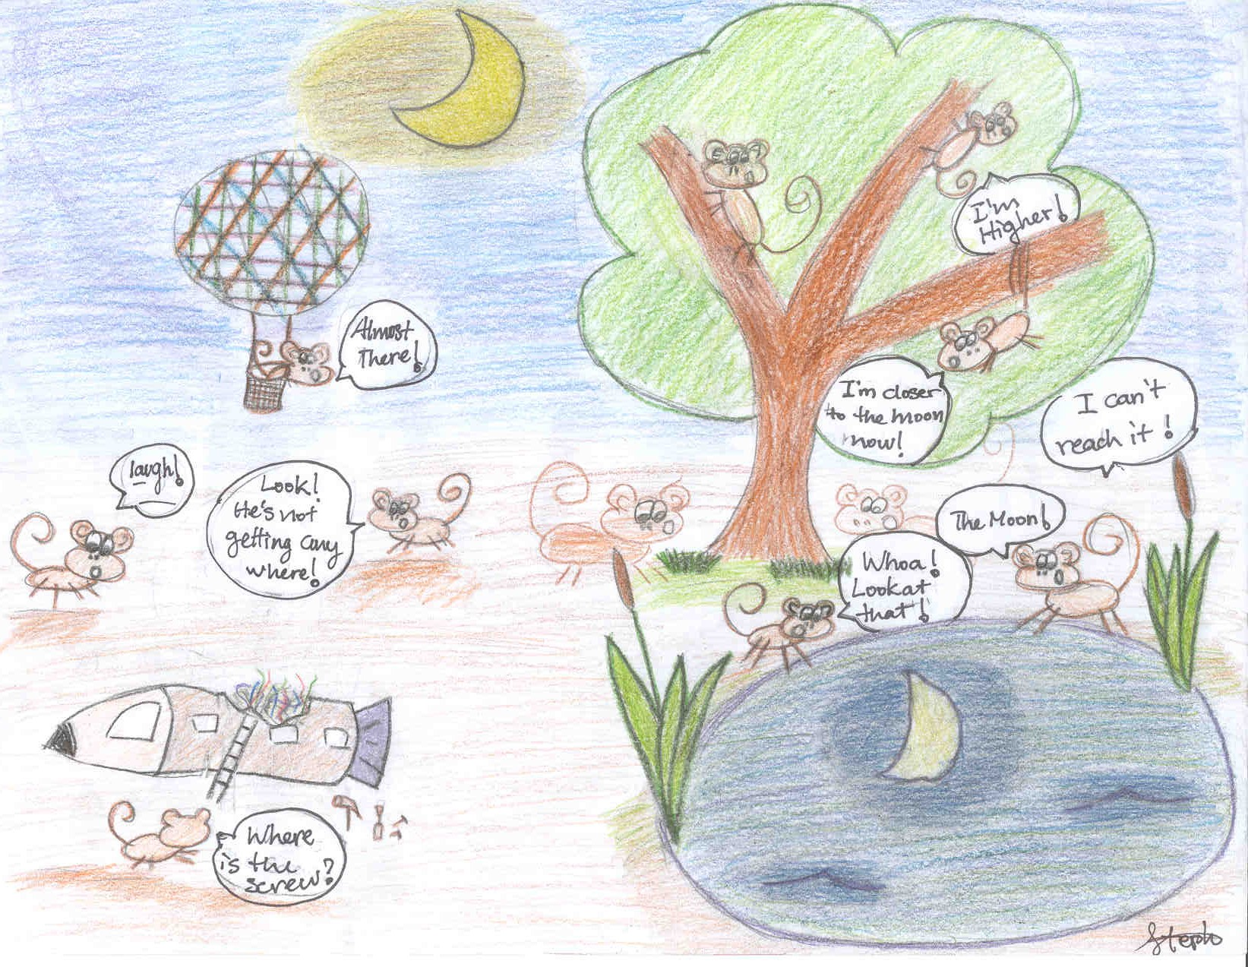
http://www.stat.ucla.edu/~sczhu/research_blog.html

Slide 4
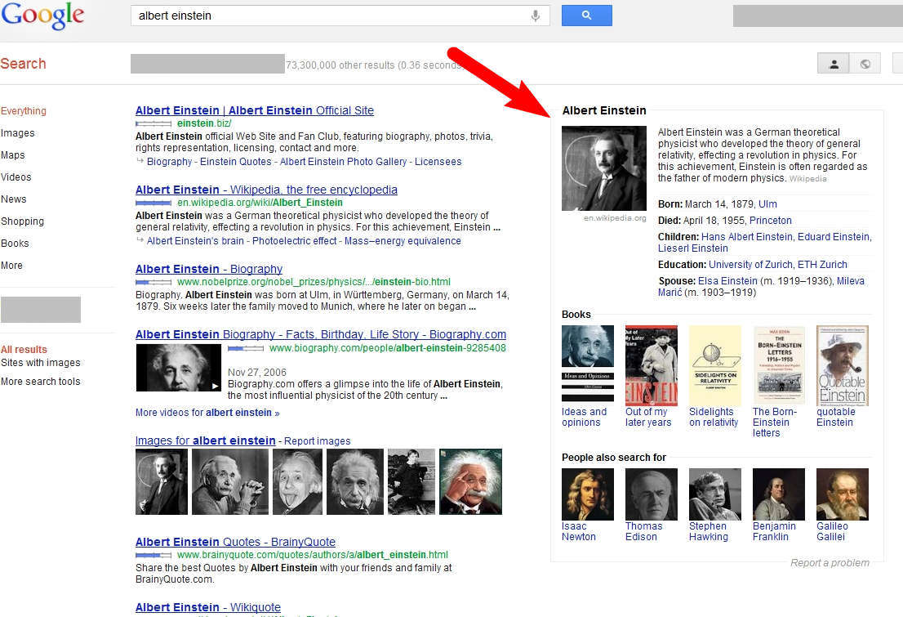
Google Knowledge Graph
Launched in May 2012
570 million entities and 18 billions of relationships

Slide 5
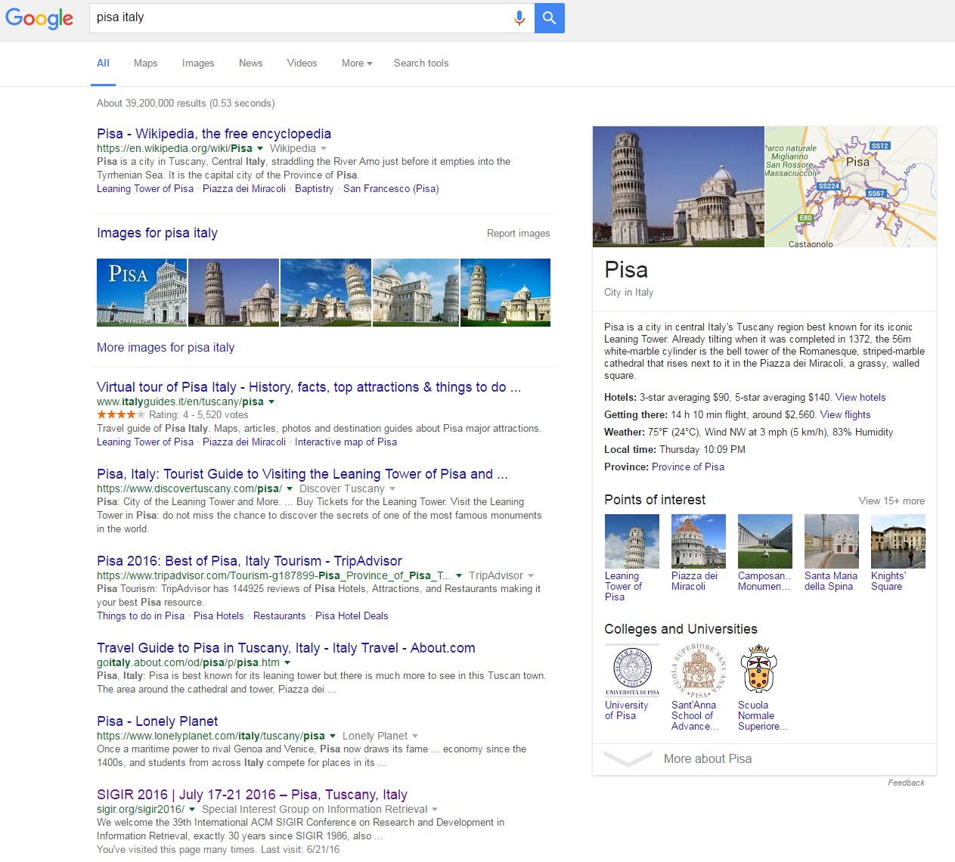
Surfacing structured results in web search
Augmenting the presentation with relevant facts

Slide 6
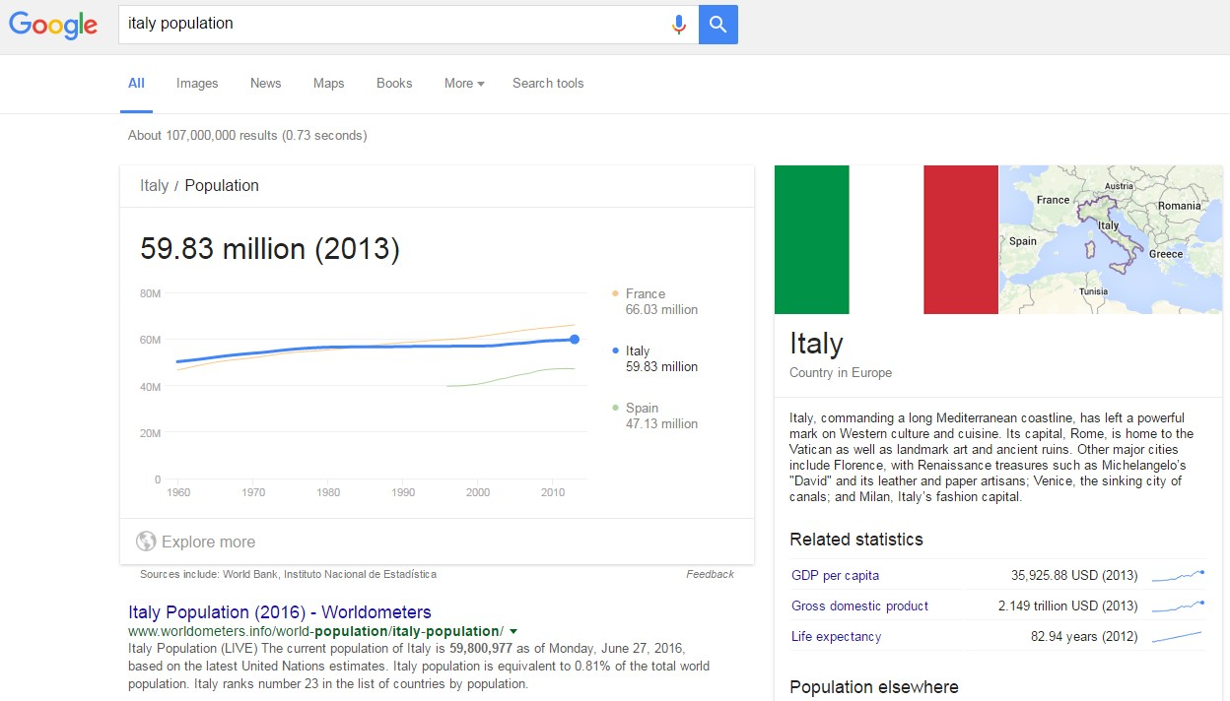

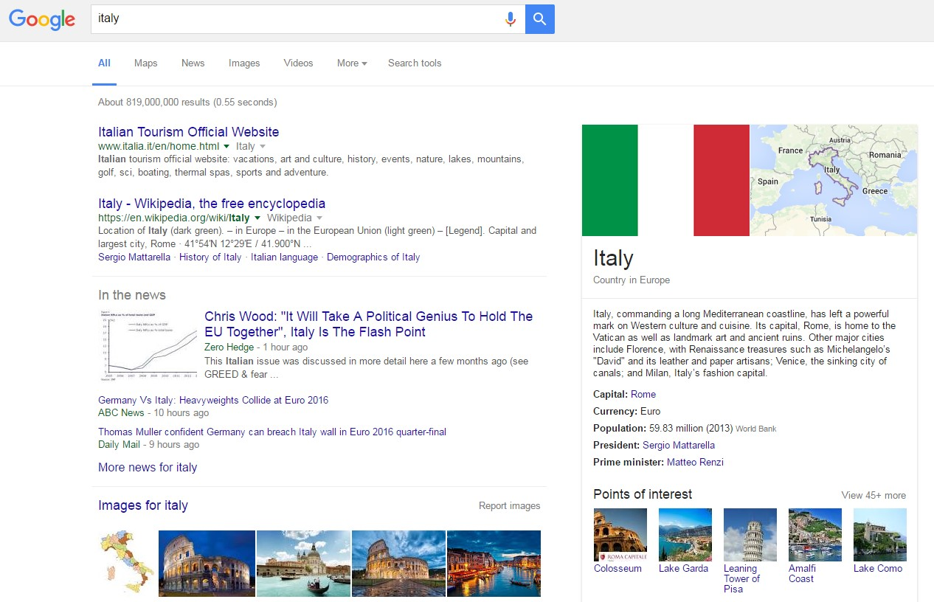

Surfacing facts proactively

Slide 7
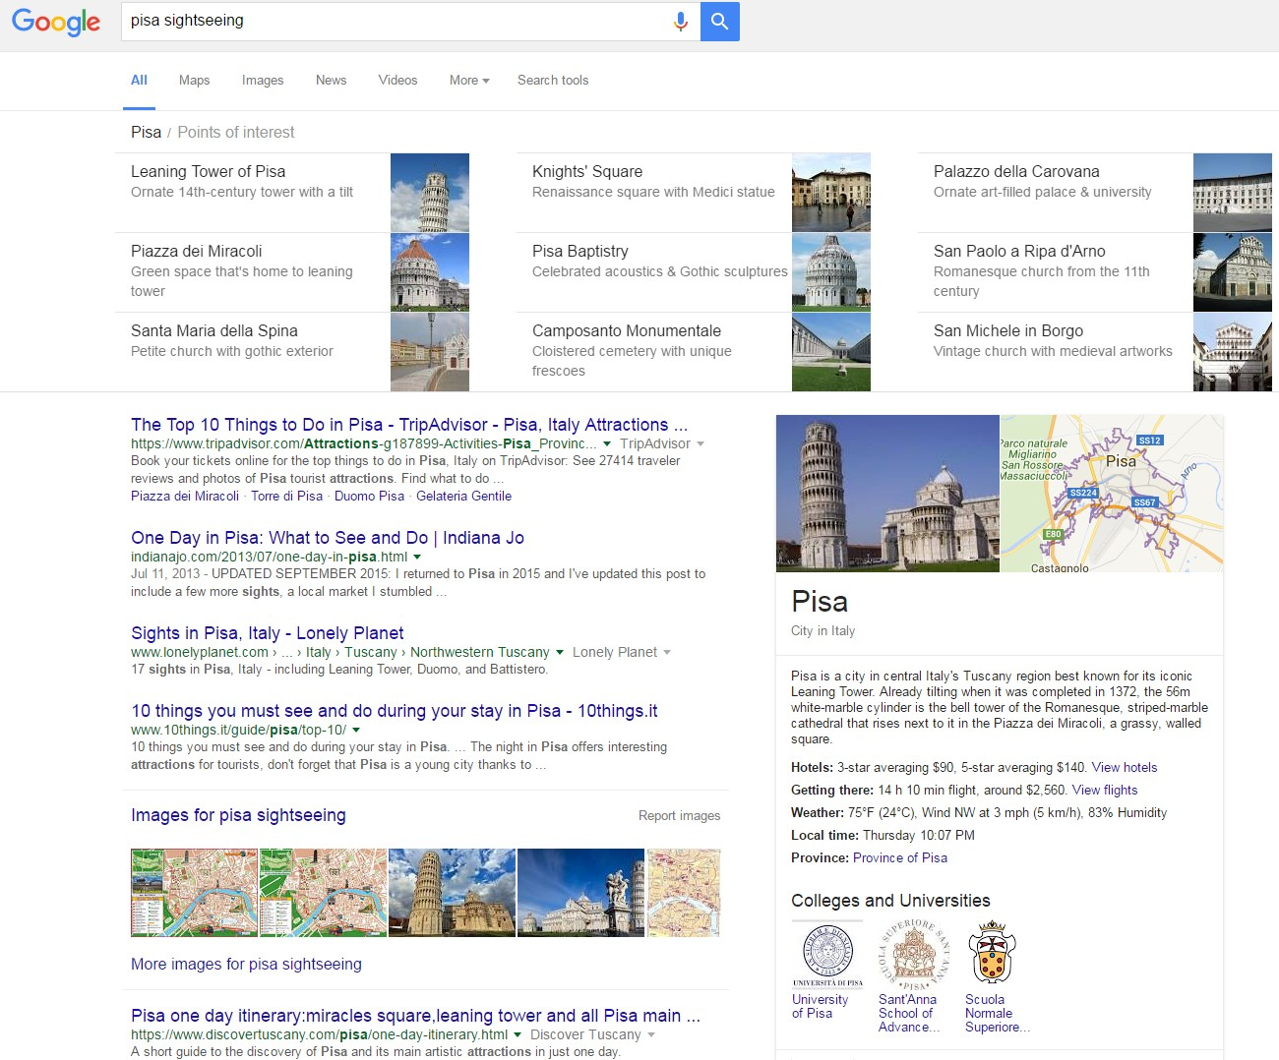
Exploratory search

Slide 8
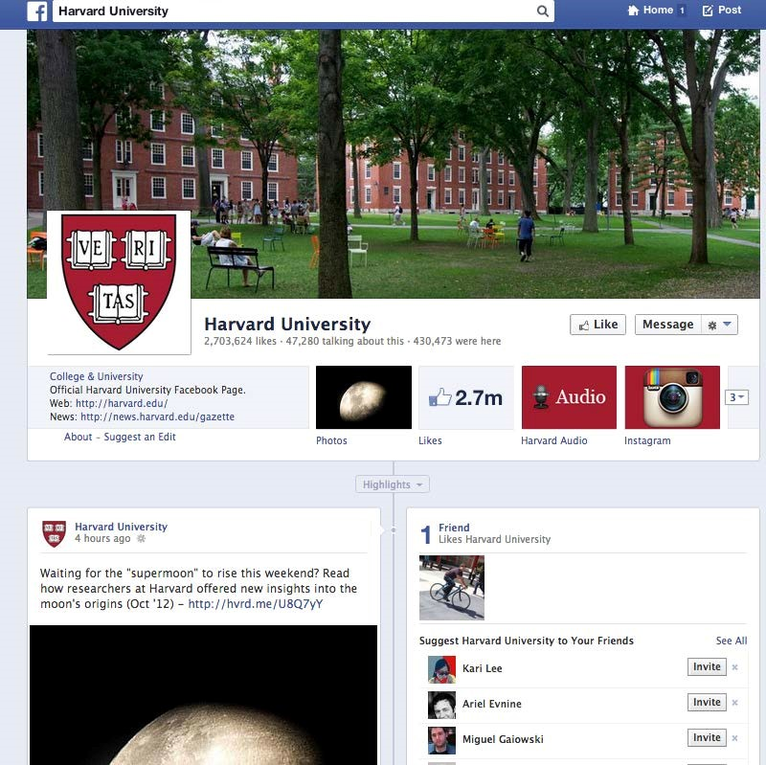
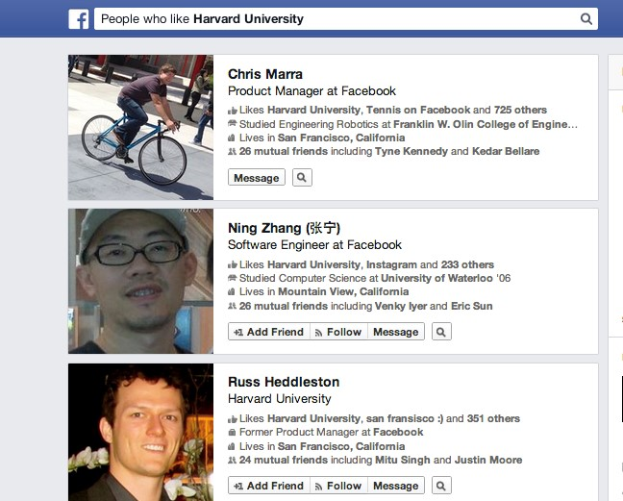
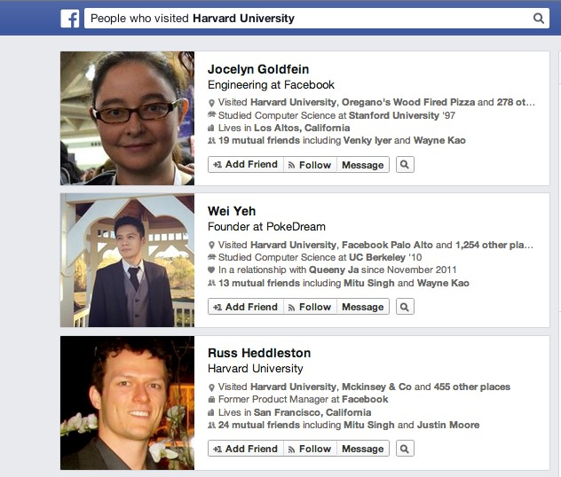
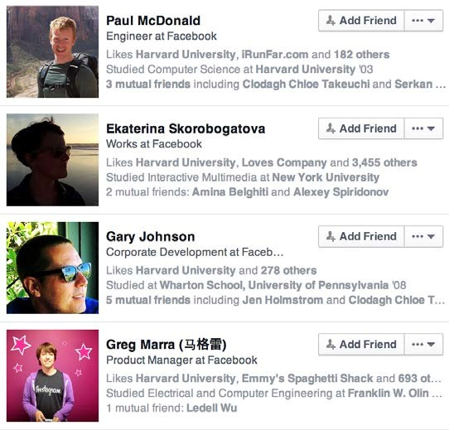
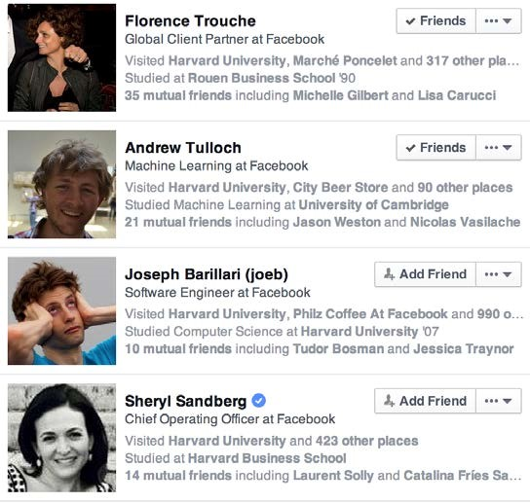
Connecting people, places, and things

Slide 9
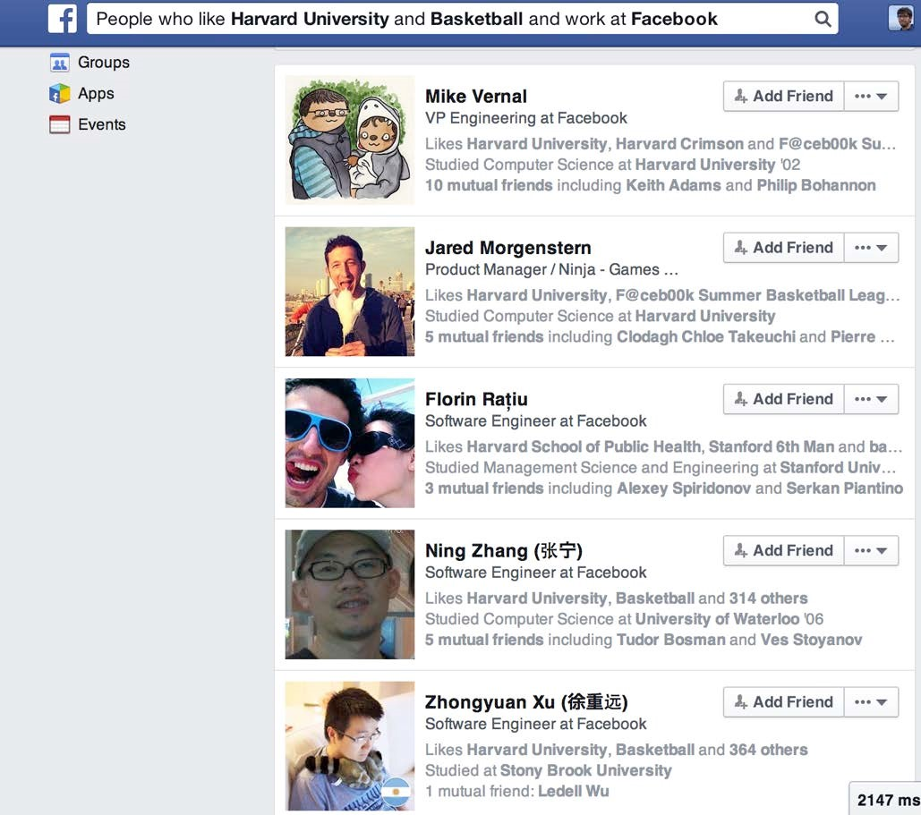
Connecting people, places and things
Structured search within the graph

Slide 10
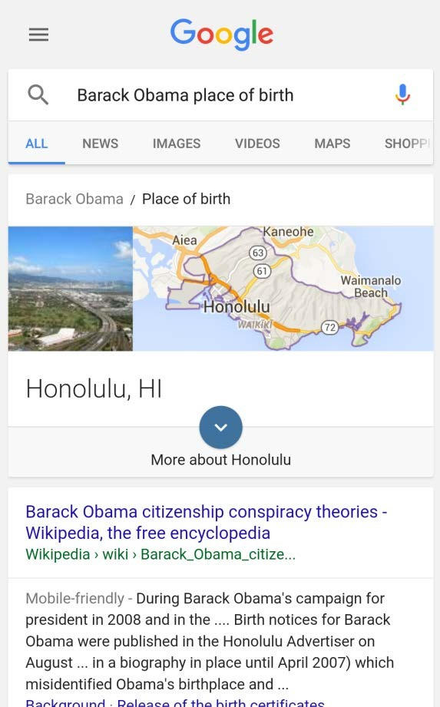
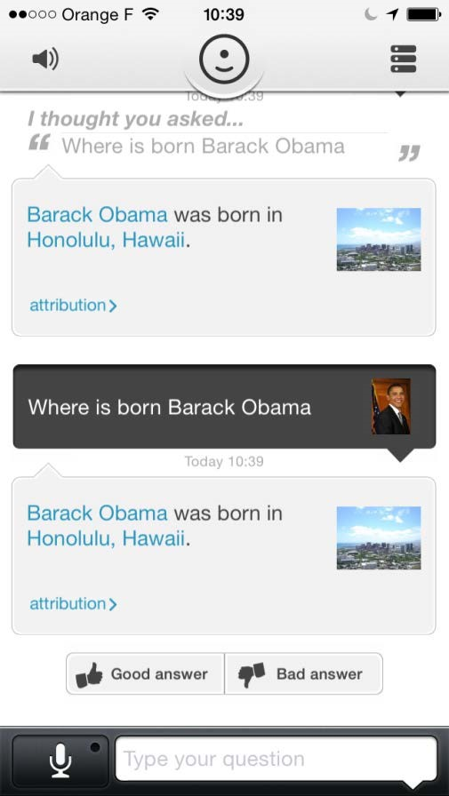
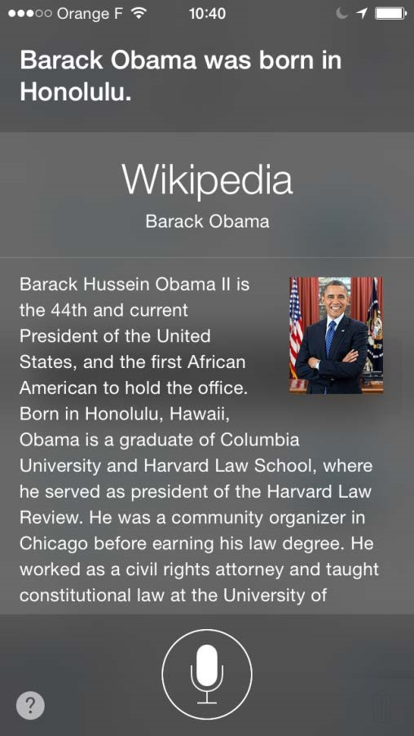
Towards a knowledge-powered digital assistant
Google Amazon Apple
Natural way of accessing/storing knowledge
Dialogue system
Personalization
Emotion

Slide 11
Knowledge Base Summary
WordNet
Expert annotation
Linguistic
Cyc
Expert annotation
Formalized logical reasoning
ConceptNet (MIT)
Crowdsourcing
Context-based inferences over real-world texts
KnowItAll (UW), NELL (CMU)
Information Extraction
Triplets (entities and relations)
Google Knowledge Graph
Combination
Triplets (entities and relations)

Slide 12
Outline
What is a knowledge graph?
What are the key techniques used in information extraction to construction scalable knowledge graphs?
What kinds of techniques are used in Google knowledge graph, the world’s largest knowledge graph?

Slide 13




Cyc: Expert Annotation
Knowledge
Users
Knowledge
Authors
User Interface
(with Natural Language Dialog)
Other
Applications
Knowledge Entry Tools
Cyc
Cyc API
Reasoning
Modules
Cyc
Ontology &
Knowledge
Base
Interface to
External Data Sources
External
Data
Sources
Data
Bases
Web
Pages
Text Sources
Other KBs
Notes:
With these topics. Cyc builds a complex reasoning system. This system includes several components. The core component is Cyc Ontology & knowledge base and the reasoning modules. It provides an interface to ~, such as ~ . It also provides tools to enable knowledge authors to edit knowledge. For applications, it provides cyc apis. And for knowledge users, it provides user interface with natural ~

Slide 14
History of CYC
1967 – AI is used on toy problems.
1977 – Expert systems reason in narrow domains.
1983 – Lenat, Minsky, Feigenbaum, Kay, and others recognize need for a substrate of shared world knowledge; and realize it would take hundreds of person-years to “prime the pump”.
1984 – MCC recruits Doug Lenat from Stanford to create a commonsense knowledge base overcoming the brittleness of then current expert systems
Notes:
Cyc has a long history.

Slide 15
History of CYC (Cont’d)
1995 - As corporate sponsorships diminished, the Cyc project was spun-off into Cycorp, the company.
Late 1990’s – Cycorp completes the tenth rewrite of its inference engine and object store and begins its migration from Symbolics Lisp Machines to Linux PCs
1999 Cycorp strengthens its relationships with US military and intelligence community sponsors, which to this day provide the majority of its funding – believing that a commonsense ontology is a hub for integrating disparate military and intelligence systems
2001 – OpenCyc released
2006 – Cycorp implements a Java runtime for its Lisp source code

Slide 16
Current State
Today, Cyc has contained more than:
16,000 predicates;
1,000 reasoning modules;
300,000 concepts;
4,000 physical devices;
400 event-participant relationships;
11,000 event types;
171,000 “names” (chemicals, persons, places, etc.);
1,100 geospatial classes and 500 goespatial predicates;
3.2 million assertions.
Notes:
Currently, Cyc begins to take shape. It contains ~

Slide 17

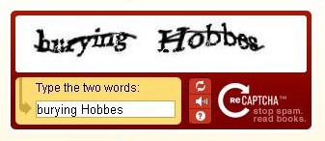
Collecting Commonsense: Crowdsourcing

Slide 18
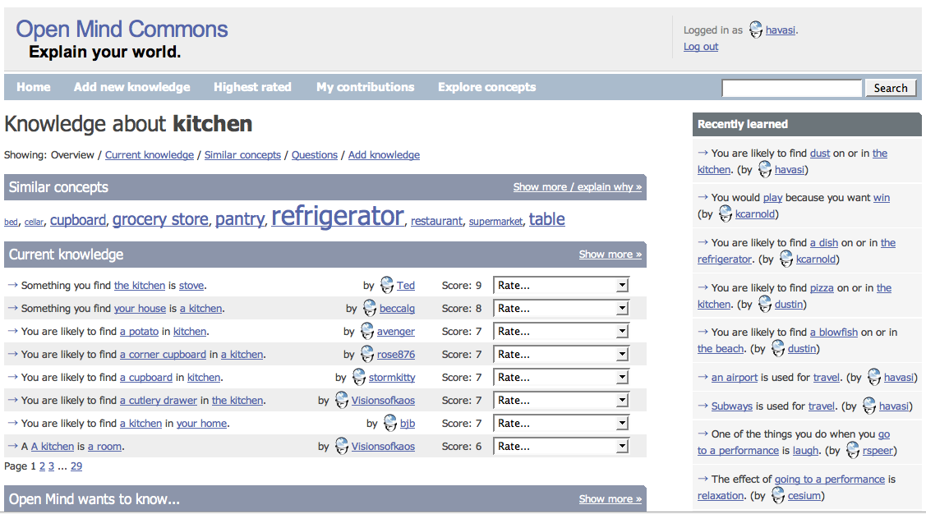
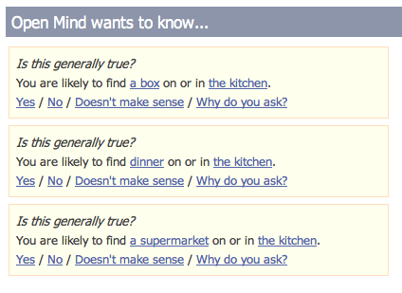
ConceptNet (MIT)

Slide 19
Comparison
 | Database content | Resource | Capabilities
ConceptNet (2002) | Commonsense | OMCS (from the public) (automatic) | Contextual inference
WordNet (1985) | Semantic Lexicon | Expert (manual) | Lexical categorisation & word-similarity
Cyc (1984) | Commonsense | Expert (manual) | Formalized logical reasoning
OMCS: Open Mind Common Sense
Notes:
ConceptNet : is generated automatically from OMCS corpus (general public) about 4 years
WordNet, Cyc: is manually handcrafted by knowledge engineers (knowledge engineers at Cycorp) 20 years
ConceptNet :
Structure like WordNet, relationally rich like Cyc
(simple-to-use representation) (rich content)

Slide 20
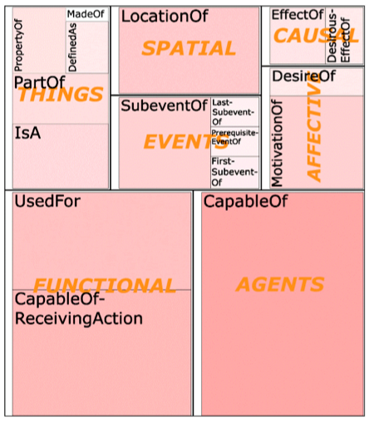
Structure of the ConceptNet knowledge base
1.6 million assertions (1.25 million are k-lines)
twenty relation-types
Notes:
ConceptNet knowledge base consist of 1.6 million assertions and 20 relation-types.
K-lines is mean the different sorts of generic conceptual connections.
This picture is descrbes the ConecptNet’s relational ontology.
(an ontology is a data model that represents a set of concepts within a domain and the relationships between those concepts)

Slide 21
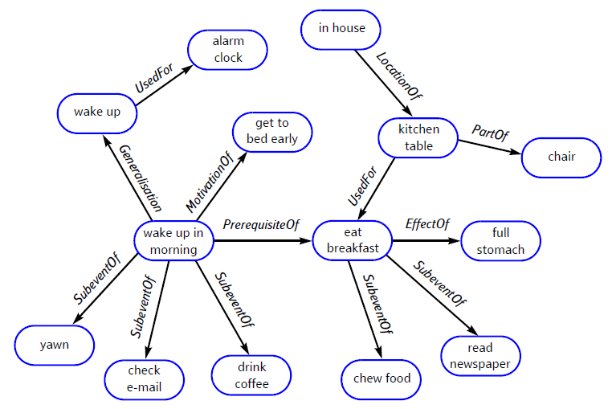
ConceptNet: An Example

Slide 22
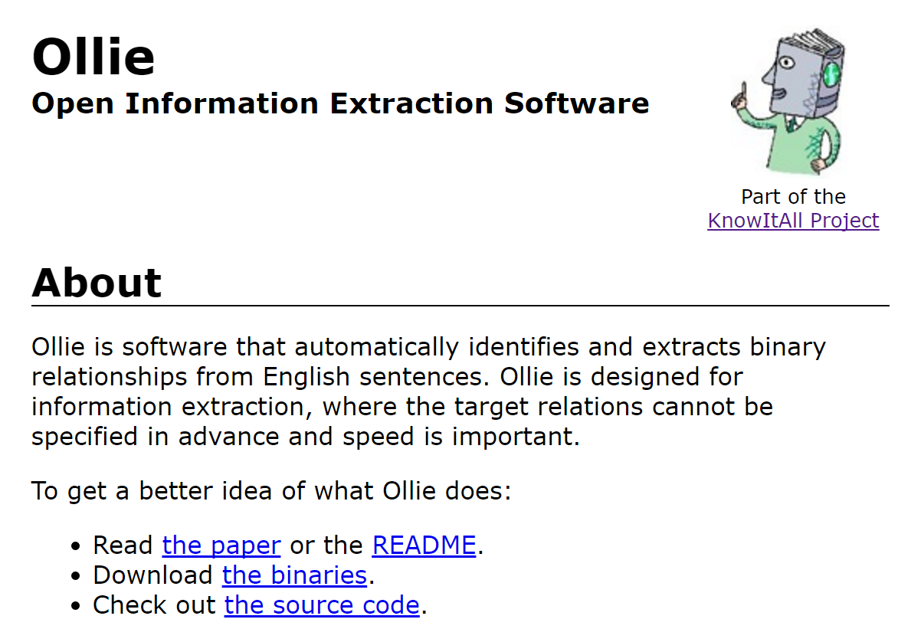
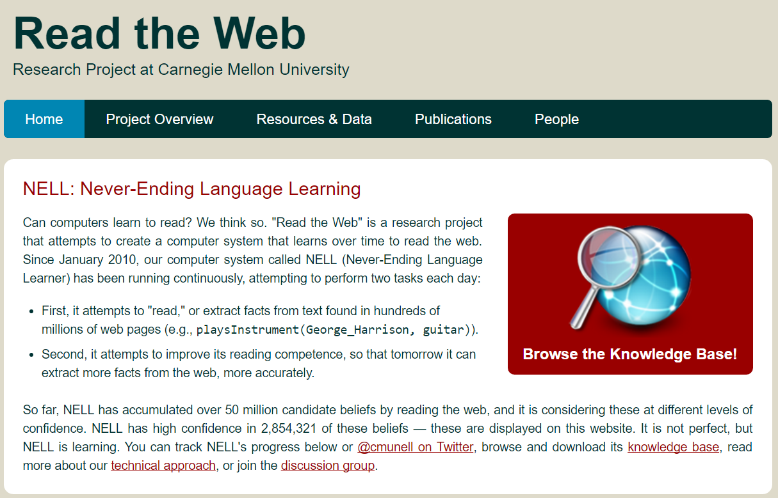
Collecting Commonsense:
Information Extraction
KnowItAll (UW)
NELL: Never Ending Language Learning (CMU)

Slide 23
Automatic Information Extraction
Observations
Diversity in text styles on the Web
Language models are complex and hard to apply
Hand-tagged document is costly
Reduce human supervision
Domain restrictions
Or just domain-specific hand tuning

Slide 24
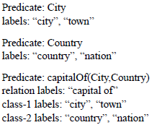
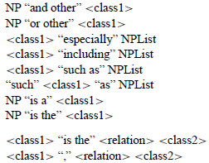
KnowItAll
City:
Beijing, Shanghai,…
Country:
China, Japan,…
capitalOf(City, Country):
(Beijing, China), (Tokyo, Japan),…
Information Focus
(two names for each class, for disambiguation)
KnowItAll
Extracted Facts according to the focus
Search Engine
Generic Extraction Patterns

Slide 25
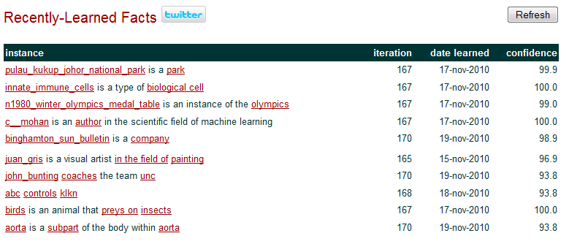
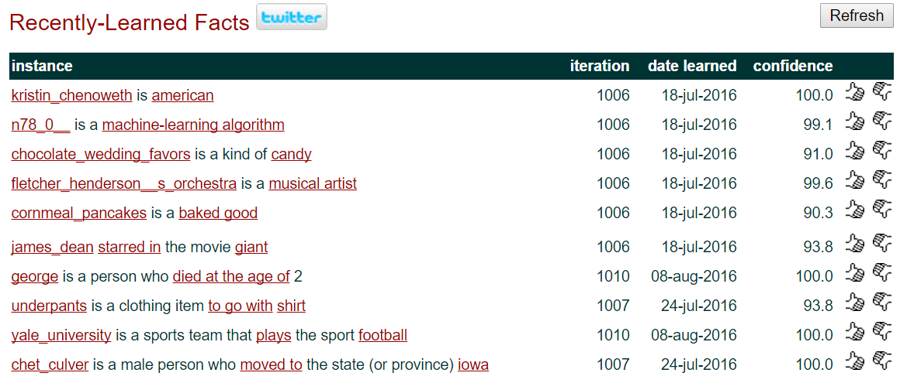
NELL: Never-Ending Language Learning
2010
2016

Slide 26
Read the Web: Problem Specification
Inputs:
initial ontology
handful of examples of each predicate in ontology
the web
occasional access to human trainer
The task:
run 24x7, forever
each day:
extract more facts from the web to populate the initial ontology
learn to read (perform #1) better than yesterday

Slide 27
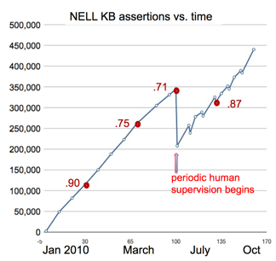
NELL, since Jan 2010
2010: “At present, NELL has accumulated a knowledge base of 497,779 beliefs that it has read from various web pages.”
2016: So far, NELL has accumulated over 50 million candidate beliefs by reading the web, and it is considering these at different levels of confidence. NELL has high confidence in 2,750,007 of these beliefs — these are displayed on this website.

Slide 28
Outline
What is a knowledge graph?
What are the key techniques used in information extraction to construction scalable knowledge graphs?
Expert annotation
Crowdsourcing
Information Extraction
What kinds of techniques are used in Google knowledge graph, the world’s largest knowledge graph?

Slide 29
Information Extraction
Entity Extraction
Relation Extraction
Event Extraction

Slide 30
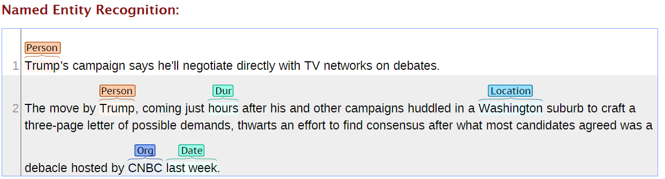
Name Tagging/Named Entity Recognition

Slide 31
Name Tagging
Recognition x Classification
“Name Identification and Classification”
NER as:
as a tool or component of IE and IR
as an input module for a robust shallow parsing engine
Component technology for other areas
Question Answering (QA)
Summarization
Automatic translation
Document indexing
Text data mining
Genetics
…

Slide 32
Name Tagging
NE Hierarchies
Person
Organization
Location
But also:
Artifact
Facility
Geopolitical entity: somewhat like location, but can be a government entity
Vehicle
Weapon
Etc.

Slide 33
Name Tagging
Handcrafted systems
Knowledge (rule) based
Patterns
Gazetteers
Automatic systems
Statistical
Machine learning
Unsupervised
Analyze: char type, POS, lexical info, dictionaries
Hybrid systems

Slide 34
Name Tagging: Task
Person (PER): named person or family
Organization (ORG): named corporate, governmental, or other organizational entity
Geo-political entity (GPE): name of politically or geographically defined location (cities, provinces, countries, international regions, bodies of water, mountains, etc.)
Convert it into a sequence labeling problem – “BIO” tagging:
<PER>George W. Bush</PER> discussed <GPE>Iraq</GPE>
B-PER
I-PER
I-PER
O
B-GPE
George
W.
Bush
discussed
Iraq

Slide 35
Typical Name Tagging Features
N-gram: Unigram, bigram and trigram token sequences in the context window of the current token
Part-of-Speech: POS tags of the context words
Gazetteers: person names, organizations, countries and cities, titles, idioms, etc.
Word clusters: to reduce sparsity, using word clusters such as Brown clusters (Brown et al., 1992)
Case and Shape: Capitalization and morphology analysis based features
Chunking: NP and VP Chunking tags
Global feature: Sentence level and document level features. For example, whether the token is in the first sentence of a document
Conjunction: Conjunctions of various features

Slide 36
Deep Neural Networks
B/I/O
CRFs / Softmax
Concatenation Layer
Hidden Layer
LSTMs Hidden Layer
Left LSTM
Right LSTM
Left LSTM
Right LSTM
Word Input Embedding
Linguistic Features Embedding
Word Embedding
- Name Patterns
- Lexicons
- Gazetteers
- Typing
- Rules
Left LSTM
Right LSTM
Characters Embedding
Features

Slide 37
Relation Extraction

Slide 38
Semi-supervised relation extraction
Generic algorithm
Start with seed triples / golden seed patterns
Extract patterns that match seed triples/patterns
Take the top-k extracted patterns/triples
Add to seed patterns/triples
Go to 2
Many published approaches in this category:
Dual Iterative Pattern Relation Extractor [Brin, 98]
Snowball [Agichtein & Gravano, 00]
TextRunner [Banko et al., 07] – almost unsupervised
Differ in pattern definition and selection

Slide 39
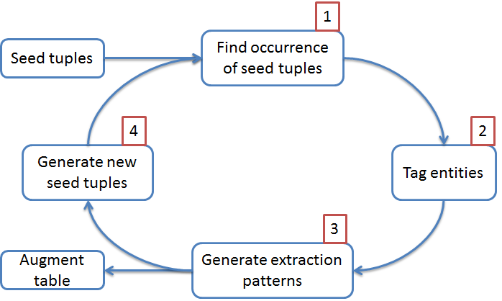
Snowball [Agichtein & Gravano, 00]

Slide 40
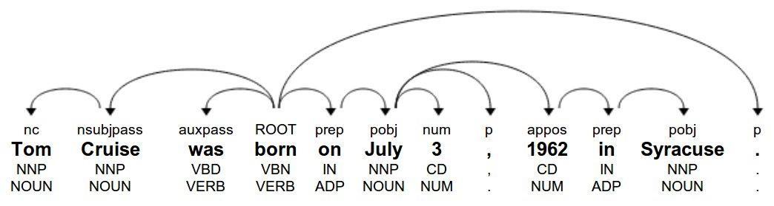
Supervised relation extraction
Pros
High quality supervision
Explicit negative examples
Cons
Very expensive to generate supervision
Not easy to add more relations
Cannot generalize to text from different domains
X was born on DDDD in Y
DEP: X <nsubjpass / born prep> on pobj> DATE prep> in pobj> Y
NER: X = PER, Y = LOC
POS: X = NOUN, NNP; Y = NOUN, NNP
Context: born, on, in , "born on"

Slide 41





Event Extraction
CAUSAL
SUB-EVENT
COREFERENCE
US congress
(agent)
NSF
(organization)
Lockheed
Martin
(Employer)
Obama
(attendee)
Barack Obama
(approver)
[Title: President
Employer: US]
MEET
CLOSE-ORG
LEAVE
CLOSE-ORG
SIGN
COREFERENCE
Healthcare
reform
(cause)
DARPA
(organization)
US
government
(organization)
John Boehner
(attendee)
[Title: House Speaker
Member of: Republican
Residence: Ohio]
3000
Workers
(Employee)
Obamacare
(act)
2010/03/03
Doc1
2013/10/01
Doc2
2013/10/02
Doc3
2013/10/02
Doc4
2013/10/03
Doc5

Slide 42
Outline
What is a knowledge graph?
What are the key techniques used in information extraction to construction scalable knowledge graphs?
What kinds of techniques are used in Google knowledge graph, the world’s largest knowledge graph?

Slide 43
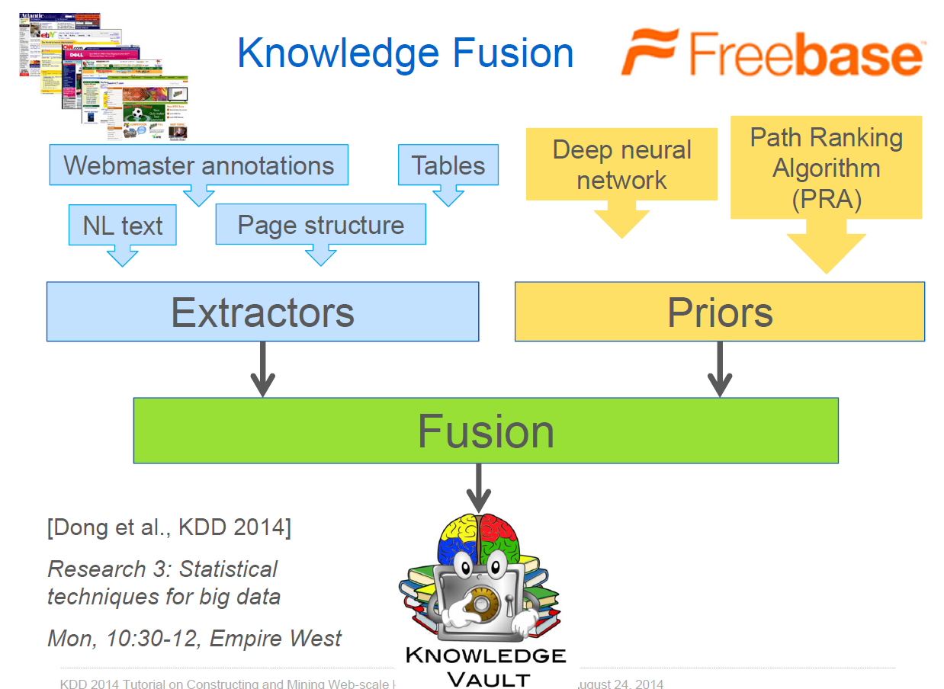
Google Knowledge Vault (2014)

Slide 44
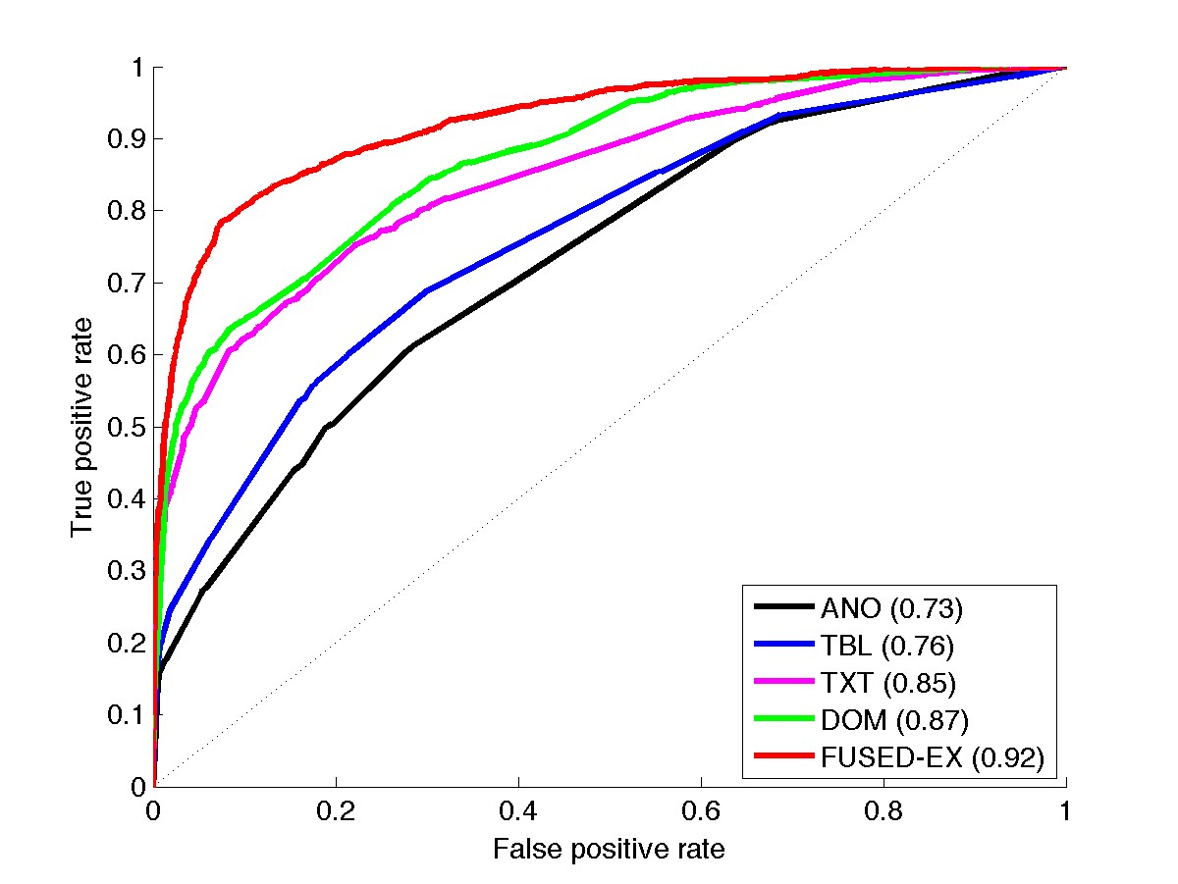


Fusing multiple extractors
Text documents (TXT)
HTML trees (DOM)
HTML tables (TBL)
Human Annotated pages (ANO)

Slide 45
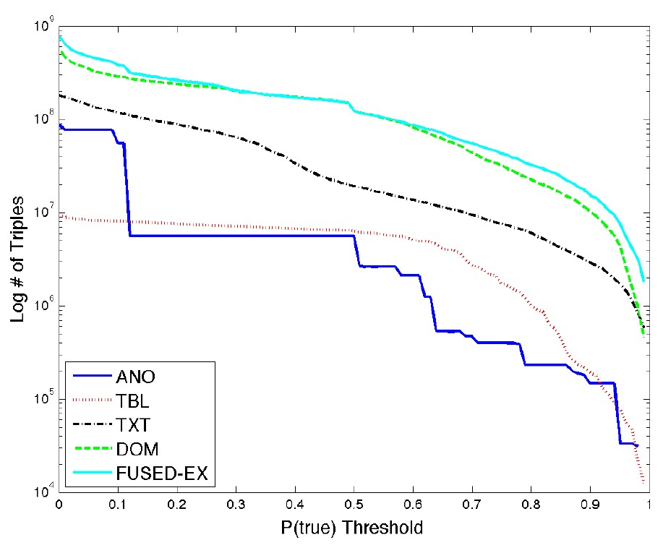
The yield from different extraction systems
Text documents (TXT)
HTML trees (DOM)
HTML tables (TBL)
Human Annotated pages (ANO)

Slide 46
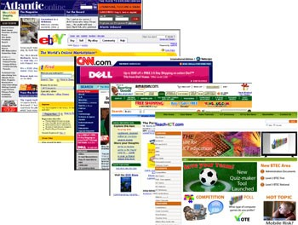


Fusing extractors with priors
Extractors
Graph priors
Fusion

Slide 47
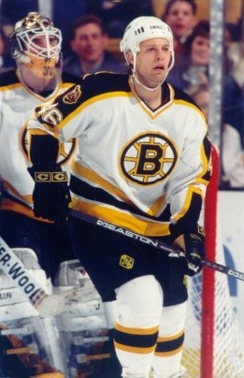
Example:
<Barry Richter, studiedAt, UW-Madison>
“In the fall of 1989, Richter accepted a scholarship to the University of Wisconsin, where he played for four years and earned numerous individual accolades ...”
“The Polar Caps' cause has been helped by the impact of knowledgeable coaches such as Andringa, Byce and former UW teammates Chris Tancill and Barry Richter.”
<Barry Richter, born in, Madison>
< Barry Richter, lived in, Madison>

Slide 48
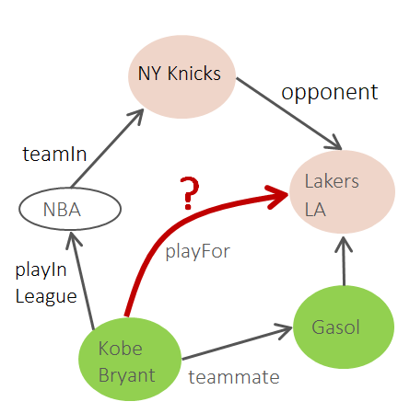
Link Prediction In KG

Slide 49
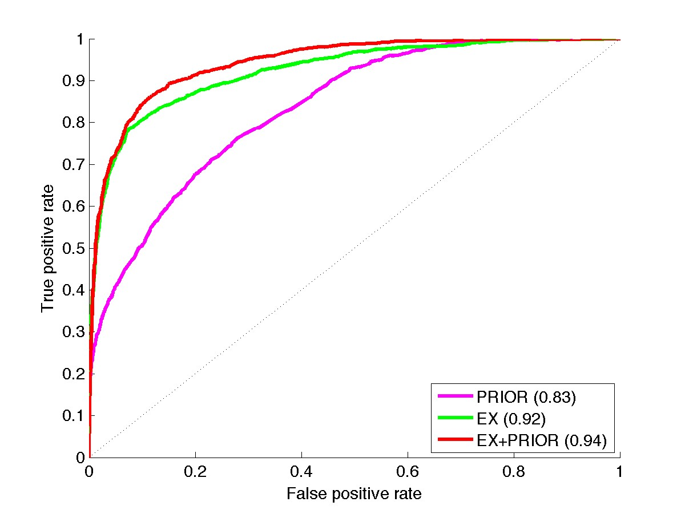


Fusing extractors with priors

Slide 50

Knowledge is crucial for many AI tasks
Knowledge brings more knowledge (the more you know, the more you can learn) → Fusion rules !
Knowledge is hard to acquire
A lot can be found online, but a lot more cannot be found
A lot cannot be extracted using today’s methods

Slide 51
A sampler of research problems
Growth: knowledge graphs are incomplete!
Link prediction: add relations
Ontology matching: connect graphs
Knowledge extraction: extract new entities and relations from web/text
Validation: knowledge graphs are not always correct!
Entity resolution: merge duplicate entities, split wrongly merged ones
Error detection: remove false assertions, find stale facts
Interface: how to make it easier to access knowledge?
Semantic parsing: interpret the meaning of queries
Question answering: compute answers using the knowledge graph
Intelligence: can AI emerge from knowledge graphs?
Automatic reasoning and planning
Generalization and abstraction

Slide 53
Application: KB based QA

Slide 54
Answer Questions using Structured Data
General problem setting
Information source: A “database”
Collection of records
Tables
Large scale DB with complex schema
Input: a natural language question (instead of formal “query”)
Output: Answer

Slide 55
Baseball [Green, Wolf, Chomsky & Laughery, 1961]
How many games did the Yankees play in July?

Slide 56
LUNAR [Woods, 1973]
Give me all lunar samples with Magnetite
How many samples contain Titanium?

Slide 57
Geoquery [Zelle & Mooney, 1996]
What is the capital of the state with the largest population?
What are the major cities in Kansas?

Slide 58
Early Work
Small scale & domain-specific KBs
Simple schema
Small number of entities and relations
Limited set of sensible questions
Approaches
Ad-hoc methods (e.g., manually crafting rules) can be quite effective
Semantic parsing (of questions)
Issues
Not clear if the methods are scalable
Cannot support “open-domain” question answering

Slide 59
Modern Large-scale Knowledge Graphs

Slide 60
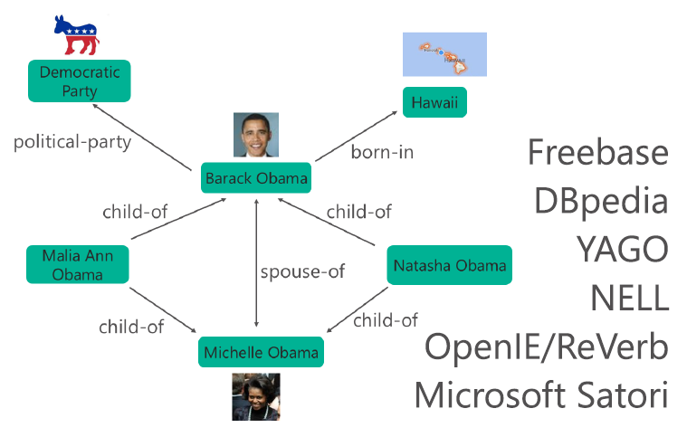
Question Answering with Knowledge Graph
Large-scale
Billions of entities
Relations among them
Question answering

Slide 61
WebQuestion Dataset [Berant et al. 13]
5,810 questions crawled from Google Suggest API and answered using Amazon Mturk
3,778 training, 2,032 testing
A question may have multiple answers → using Avg. F1
Examples:
What character did Natalie Portman play in Star Wars? => Padme Amidala
What currency do you use in Costa Rica? => Costa Rican colon
What did Obama study in school? => political science
What do Michelle Obama do for a living? => writer, lawyer
What killed Sammy Davis Jr? => throat cancer

Slide 62
Comparison

Slide 63
Comparison: NN

